Slide 1
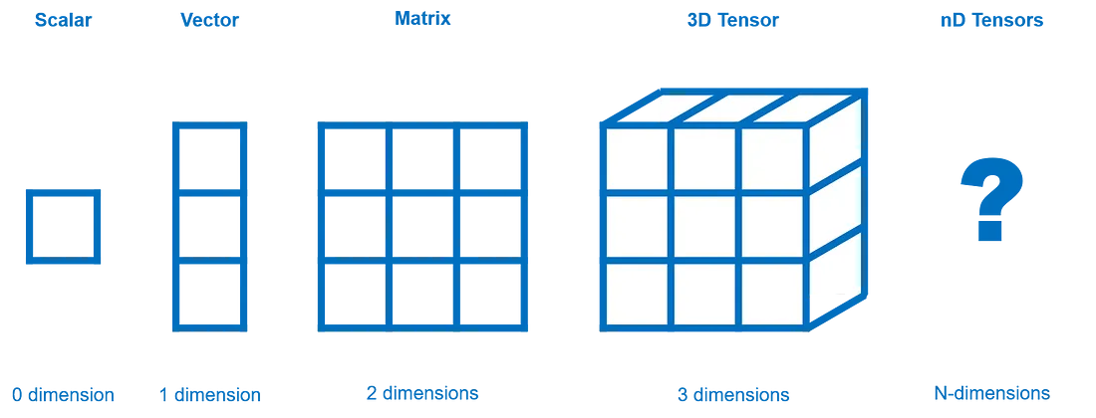
Multi Dimensional Array
Multi-Dimensional Array
Scalar, Vector , Matrix and Tensor.

Slide 2
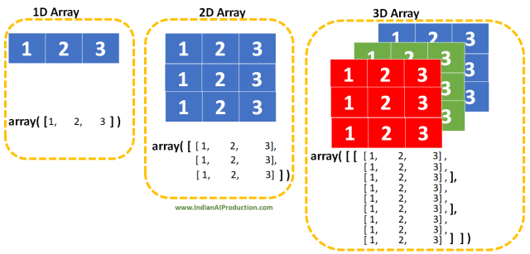
1D, 2D and 3D array
Multi-Dimensional Array

Slide 3
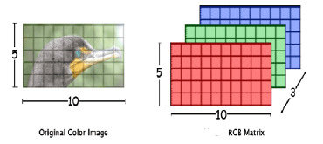
RGB image
Multi-Dimensional Array
A RGB image is actually a 3D array containing three 2D Matrices for Red, Green and Blue values.

Slide 4
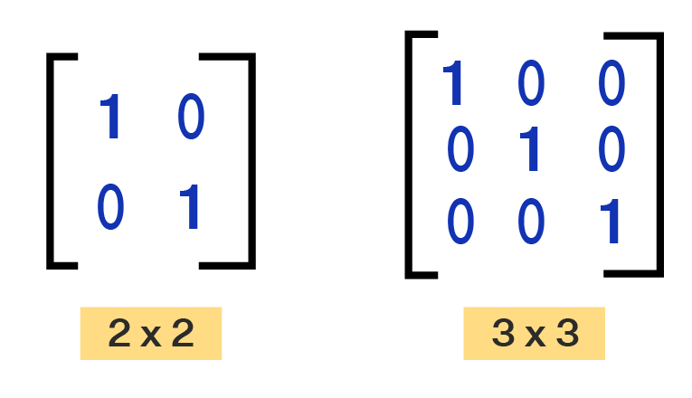
Matrix/2D Array Examples
Multi-Dimensional Array
Seating Arrangement in a classroom.
Linear Algebra Usage (Matrix representation).
Displays are 2D array of pixels.
2D MATRIX
Dimensions of matrices
Rows x Columns

Slide 5
2D Matrix in Python using Numpy
Multi-Dimensional Array
import numpy as np
arr2D = np.zeros(shape=(row,col), dtype = datatype)
arr2D = np.zeros(shape=(3,4), dtype = int) print(arr2D) | Output [[0 0 0 0] [0 0 0 0] [0 0 0 0]]
arr2D = np.zeros(shape=(3,4), dtype = float) print(arr2D) | Output [[0. 0. 0. 0.] [0. 0. 0. 0.] [0. 0. 0. 0.]]
arr2D = np.zeros(shape=(3,4), dtype = str) print(arr2D) | Output [['' '' '' ''] ['' '' '' ''] ['' '' '' '']]

Slide 6
2D Matrix from Python List using Numpy
Multi-Dimensional Array
arr2D=np.array( [[1,2,4,6],[5,7,9,8]] ) print(arr2D) print(arr2D.dtype) | Output [[1 2 4 6] [5 7 9 8]] int64
arr2D=np.array( [[1,2,4.2,6],[5,7,9,8]] ) print(arr2D) print(arr2D.dtype) | Output [[1. 2. 4.2 6. ] [5. 7. 9. 8. ]] float64

Slide 7
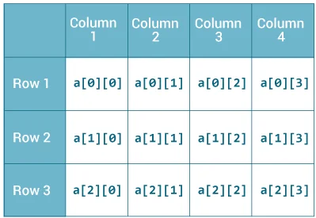
Indexing in 2D Matrix
Multi-Dimensional Array
a
a[row_num] will give us a single linear array.
a[row_num][col_num] can access individual cell.
a = np.array( [[1,2,4,6],[5,6,7,8],[9,0,1,2]] ) print(a) print("First Row", a[0]) print("Second Row", a[1]) print("Third Cell", a[0][2]) | Output [[1 2 4 6] [5 6 7 8] [9 0 1 2]] First Row [1 2 4 6] Second Row [5 6 7 8] Third Cell 4

Slide 8
Accessing the shape and size of a 2D Matrix
Multi-Dimensional Array
arr2D = np.zeros(shape=(3,4), dtype = int) print(arr2D) row, col = arr2D.shape total_cells = arr2D.size print(“Row Amount”, row) print(“Column Amount”, col) print(“Total cells”, total_cells) | Output [[0 0 0 0] [0 0 0 0] [0 0 0 0]] Row Amount 3 Column Amount 4 Total cells 12

Slide 9
Iteration of 2D Matrix
Multi-Dimensional Array
arr=np.array( [[1,2,4,6],[5,7,9,8]] ) r_len , c_len = arr.shape #The Outer loop iterates rows for r in range(r_len): #The inner loop iterates column of each row for c in range(c_len): print(arr[r][c],end=' ') print() | Output 1 2 4 6 5 7 9 8

Slide 10
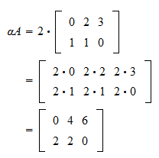
Scalar & Matrix Multiplication
Multi-Dimensional Array
A=np.array( [[0,2,3],[1,1,0]] ) print("Before",A) r_len , c_len = A.shape #The outer loop iterates rows for r in range(r_len): #The inner loop iterates column of each row for c in range(c_len): A[r][c] = 2*A[r][c] print("After",A) | Output Before: [[0 2 3] [1 1 0]] After: [[0 4 6] [2 2 0]]

Slide 11
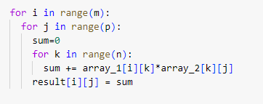
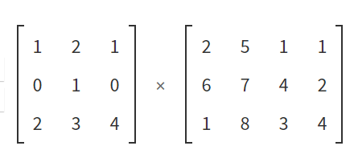
Matrix Multiplication Visual
Multi-Dimensional Array
m = 3
p = 4
n = 3
= 1x2 + 2x6 + 1x1
=

Slide 12
Matrix Multiplication Visual
Multi-Dimensional Array
m = 3
p = 4
=

Slide 13
Matrix Multiplication Visual
Multi-Dimensional Array
m = 3
p = 4
=

Slide 14
Matrix Multiplication Visual
Multi-Dimensional Array
m = 3
p = 4
=

Slide 15
Matrix Multiplication Visual
Multi-Dimensional Array
m = 3
p = 4
=

Slide 16
Matrix Multiplication Visual
Multi-Dimensional Array
m = 3
p = 4
=

Slide 17
Matrix Multiplication Visual
Multi-Dimensional Array
m = 3
p = 4
=

Slide 18
Matrix & Matrix Multiplication Code
Multi-Dimensional Array
A=np.array( [[0,5],[1,2],[3,4]] ) B=np.array( [[3,2,1],[1,2,4]] ) print("A(3,2):") print(A) print("B(2,3):") print(B) Ar_len , Ac_len = A.shape[0], A.shape[1] Br_len , Bc_len = B.shape[0], B.shape[1] #Here, Bc_len==1 and Ac_len==Br_len C=np.zeros( shape=(Ar_len,Bc_len), dtype=int) Cr_len, Cc_len = C.shape[0], C.shape[1] for i in range(Cr_len): for j in range(Cc_len): sum=0 for k in range(Br_len): sum += A[i][k] * B[k][j] C[i][j] = sum print("A X B = C(3,3):") print(C) | OUTPUT A(3,2): [[0 5] [1 2] [3 4]] B(2,3): [[3 2 1] [1 2 4]] A X B = C(3,3): [[ 5 10 20] [ 5 6 9] [13 14 19]]

